Slide 1









English Year 3
Module 4- Year In, Year Out

Slide 2



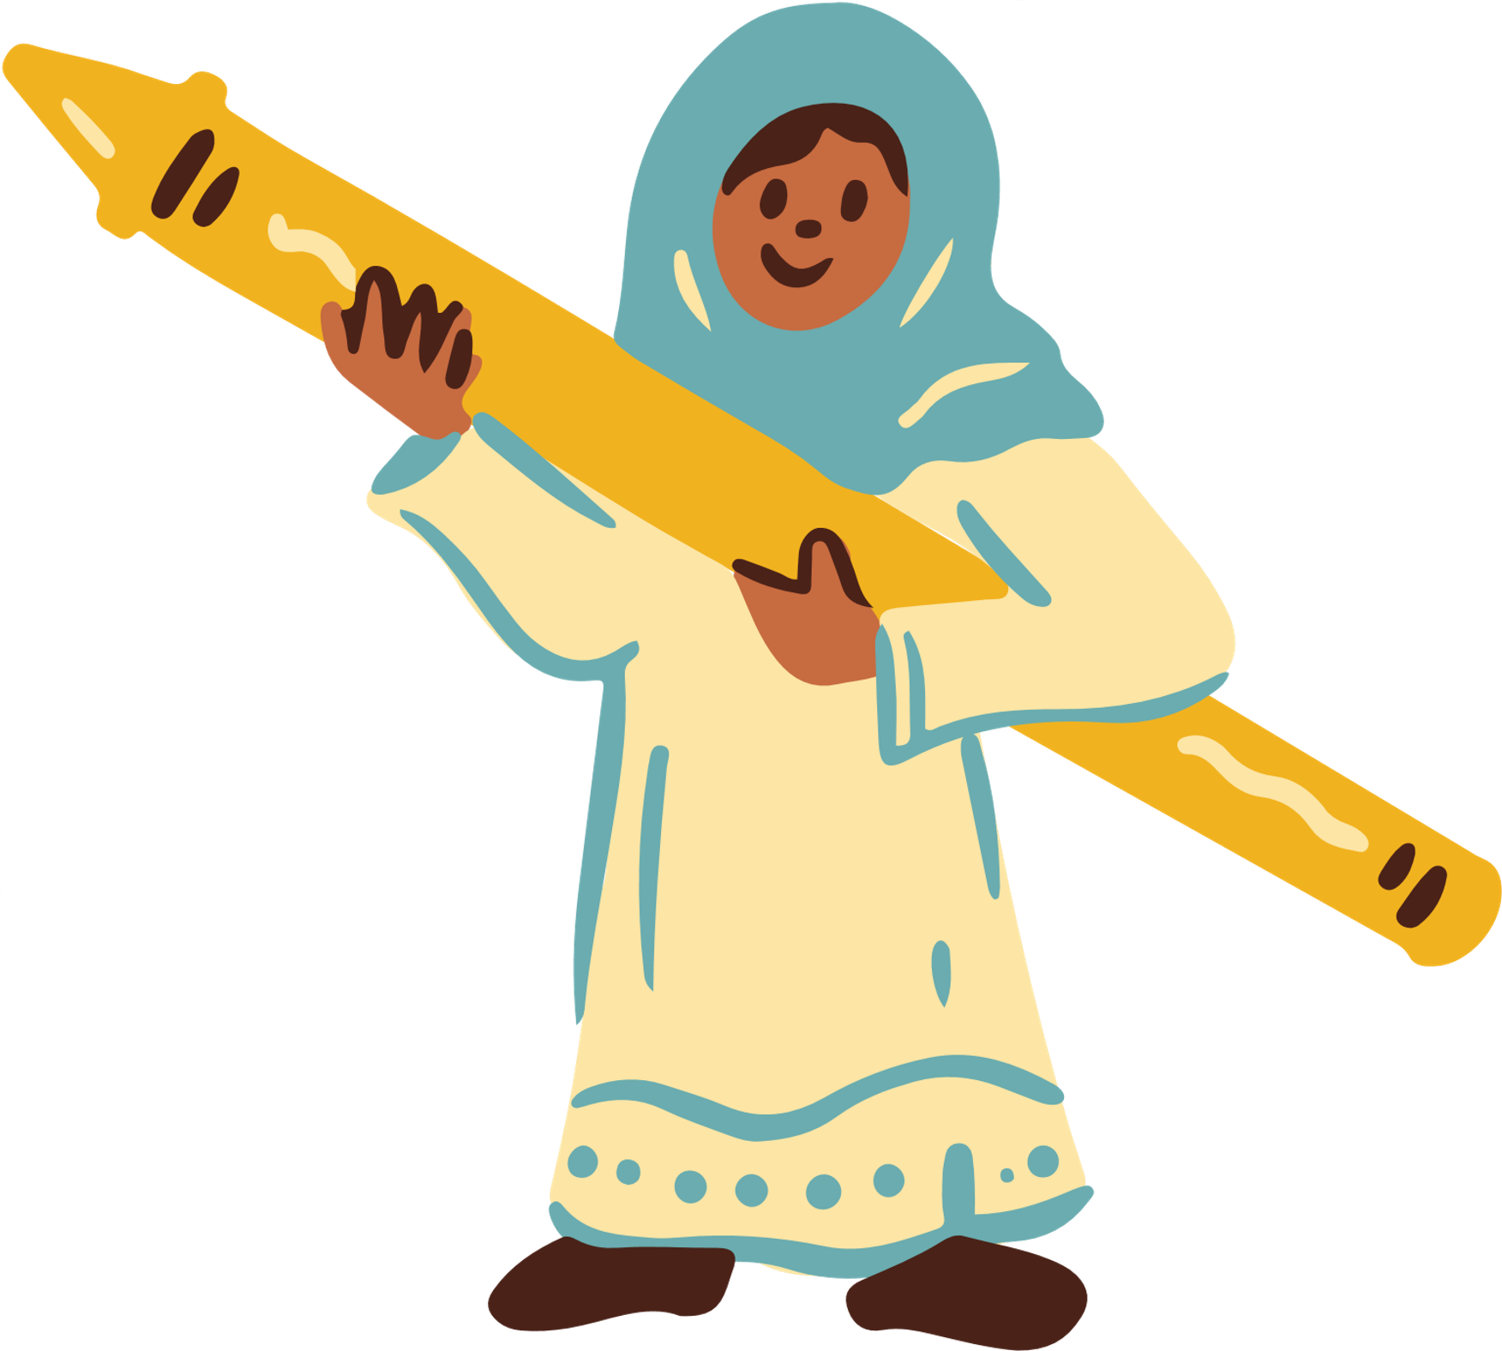

Welcome, Students!

Slide 3









Learning Objectives
By the end of the lesson, pupils will be able to:
Spell an increased range of familiar high frequency words accurately in guided writing.
Find out about and describe basic everyday routines.
Understand with support, the main idea of short simple texts.
Keep interaction going in short exchanges by repeating key words from the other speaker.

Slide 4








Today's Discussion
Today, we will be talking about weather and seasons. We will be learning how to describe and talk about these topics.
ARE YOU READY KIDS?

Slide 5





TYPES OF WEATHERS
SUNNY
SNOWY
RAINY
WINDY
CLOUDY

Slide 6




TYPES OF SEASONS
SPRING
AUTUMN
WINTER
SUMMER

Slide 7
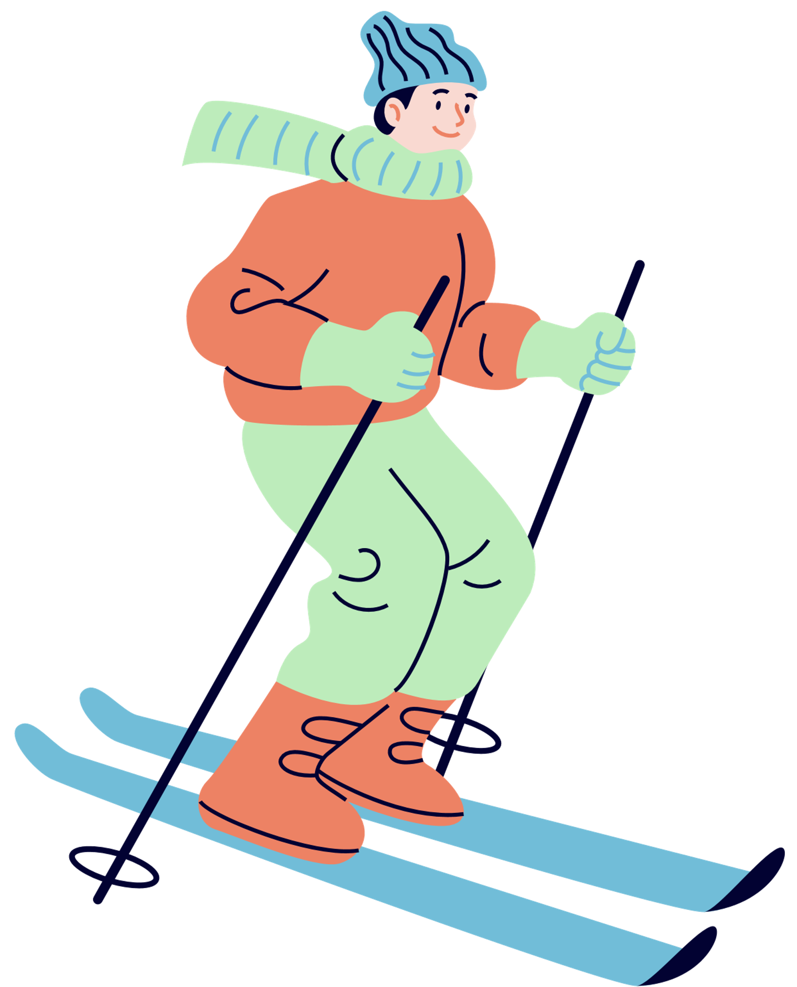

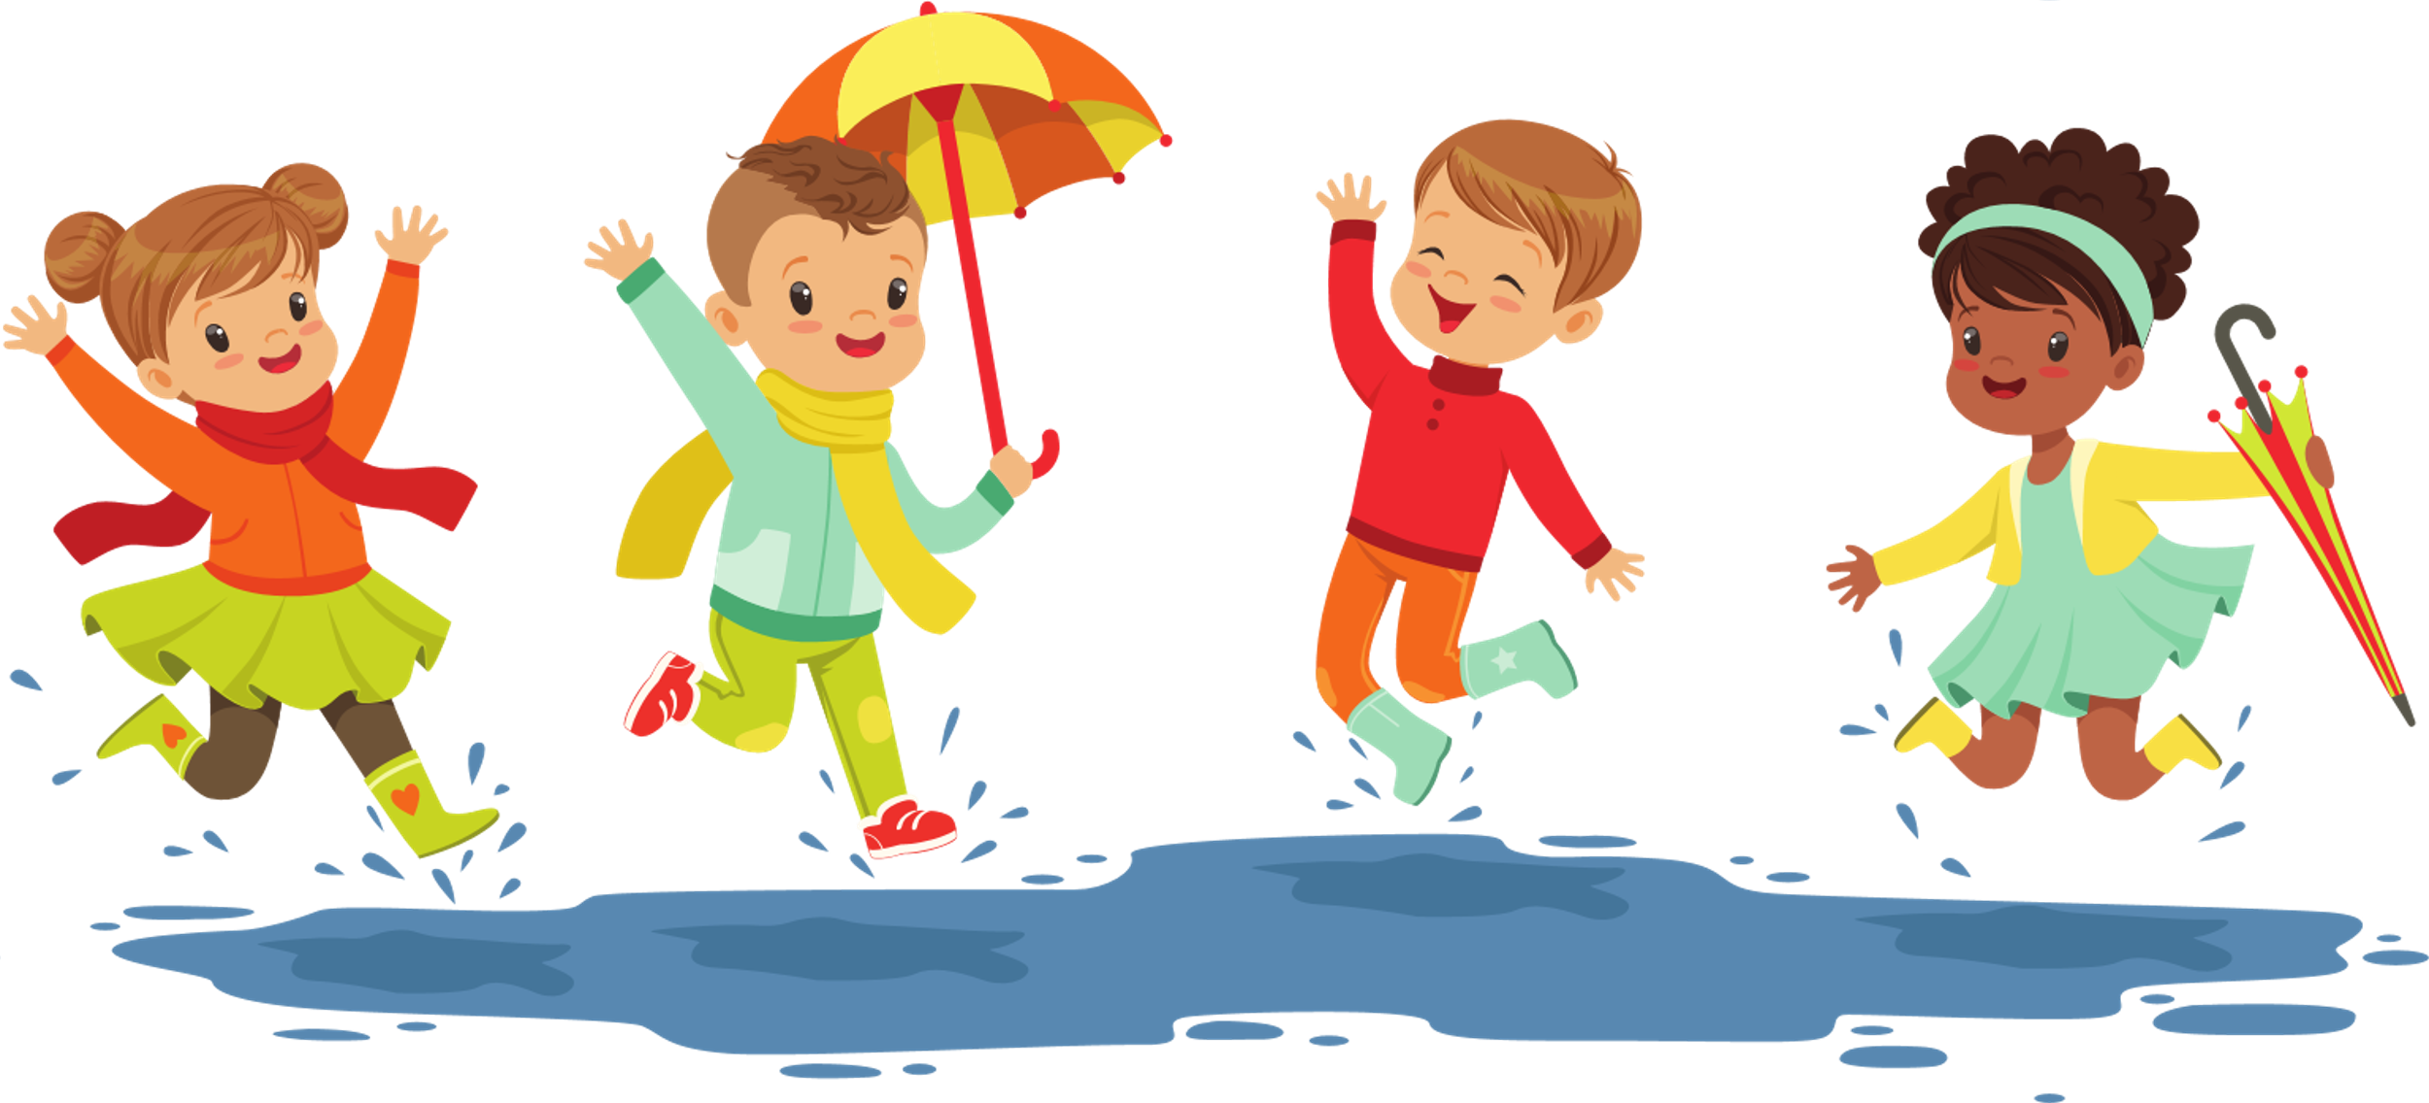
GUESSING GAME
Look at the pictures below, and guess the season / weather that these activities can take place.

Slide 8

Questions to Ask
WHAT IS YOUR FAVOURITE WEATHER / SEASON?
WHAT IS YOUR FAVOURITE THING TO DO DURING THAT WEATHER / SEASON?
WHY DO YOU LIKE THAT WEATHER / SEASON ?

Slide 9



THANK YOU!

